Slide 1
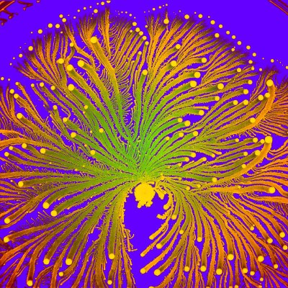
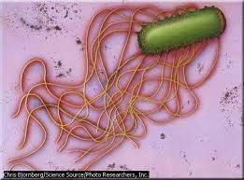
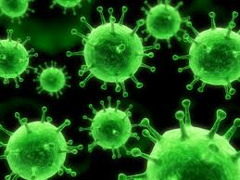
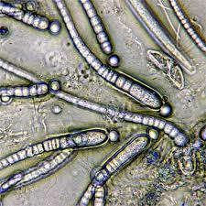
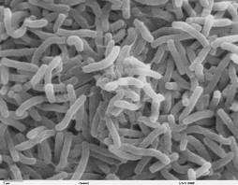
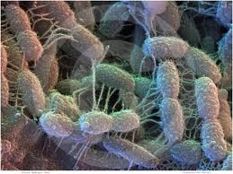
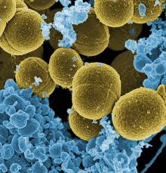
Infectious Diseases
Lesson 1.3

Slide 2
Lesson Objectives:
After finishing today’s lesson, you will be able to:
explain common practices used to avoid infectious diseases.
describe the bacterial structures that are critical for their roles in infectious disease.

Slide 3
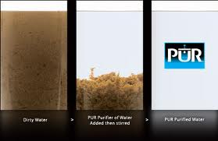
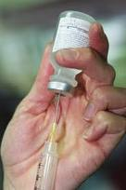
Do Now
What do we do every day to avoid getting and spreading infectious diseases? List as many behaviors as you can.
How do theses practices/habits relate to preventing infectious diseases?

Slide 4
Activity 1
On the worksheet - draw a bacterial cell and its structures. Hint: think about what is in a eukaryotic cell!

Slide 5
Activity 2
Fill in the table of bacterial structures and functions that are critical for infectious diseases.
Use the reading provided and fill in the table on the worksheet.
You will then use the table to explain the importance of the structures to the class.

Slide 6
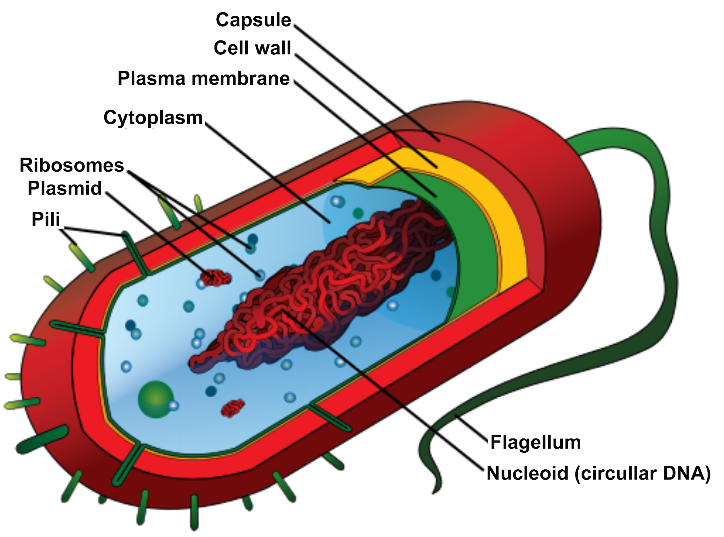
What structures make a bacterium?
D
C
B
Bacterial cell
A
I
H
G
E
F

Slide 7
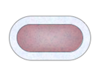
Capsule and flagellum
Bacterial cell
Capsule = protection & camo flagellum = move to food and
(pnuemonia) away from immune system
(salmonella)

Slide 8
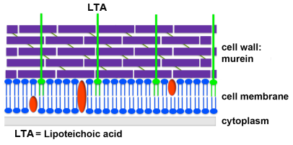
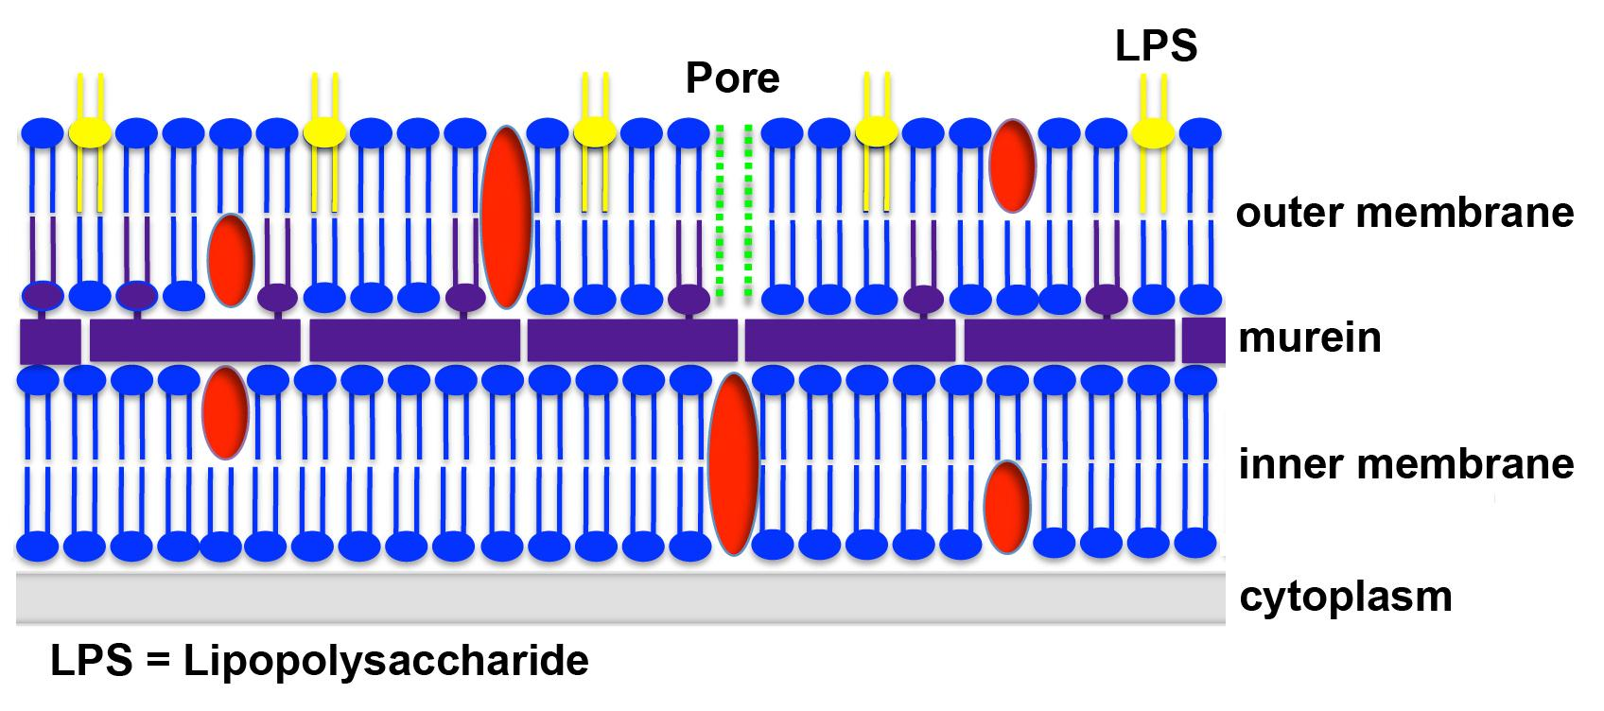
Cell Wall: Gram-positive and Gram-negative layer of protection from host and harsh environments
Gram + has a thick cell wall layer (triggers immune system with fever and inflammation)
Gram – has a thinner cell wall layer, and an outer membrane with enzymes to inactivate antibiotics (more resistant)

Slide 9
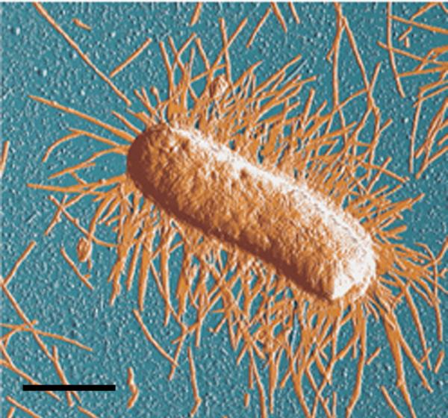
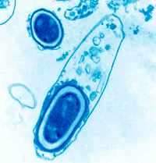
Pili and Spores
Pili help bacteria stick to surfaces (creates a biofilm = drug resistant colony)
Spores help bacteria stay alive in harsh environments (tetanus, botulism, anthrax)
Bacterial cell

Slide 10
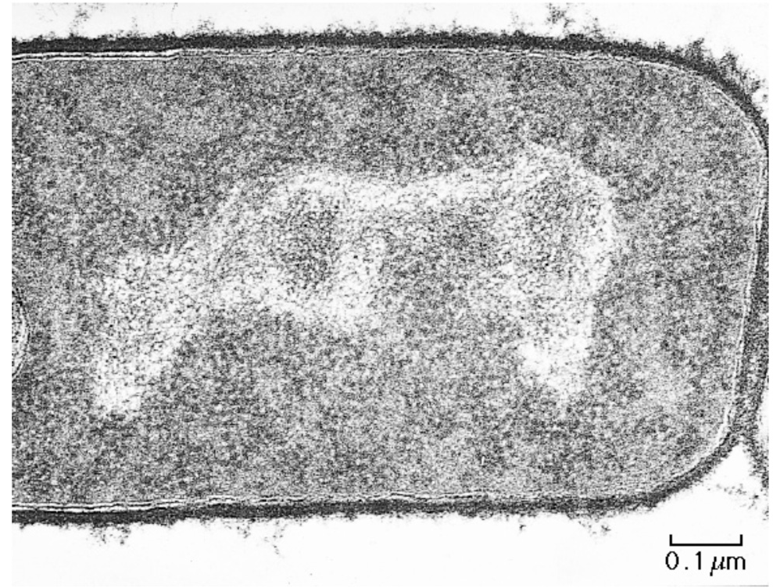
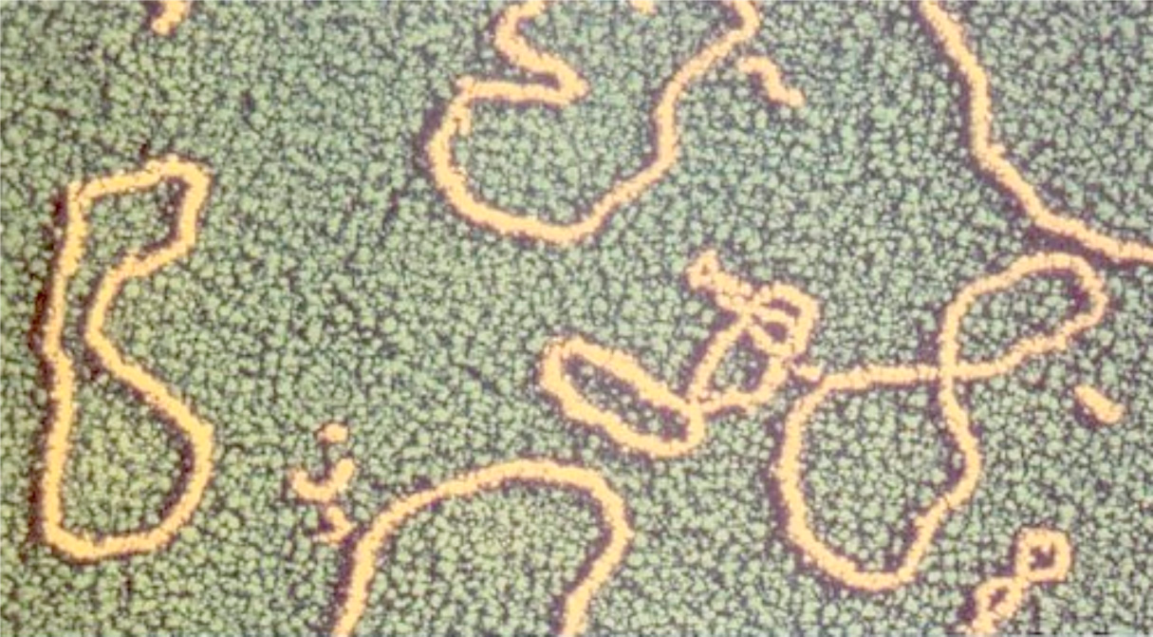
Nucleoid and Plasmid
Bacterial cell

Slide 11
Wrap Up: structure is function

Slide 12
Homework
X
f
Complete the Lesson 1.3 Worksheet.
f
f
X
f
X

